Slide 1


Accessibility Constraint Mapping for On-Road, Off-Road, Indoor Autonomous Transit and Delivery
Joshua Eckels
Joshua Eckels
|
Accessibility Constraint Mapping for On-Road, Off-Road, Indoor Autonomous Transit and Delivery
August 8, 2019

Slide 2


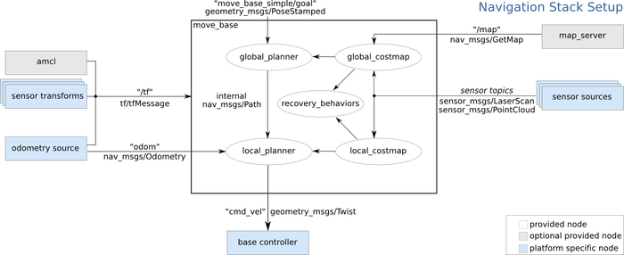
Recap
Simultaneous Localization and Mapping (SLAM)
Real-Time Appearance-Based Mapping (RTABMAP)
Computer vision
Point cloud
Global path planning
Robotic Operating System (ROS)
Joshua Eckels
|
Accessibility Constraint Mapping for On-Road, Off-Road, Indoor Autonomous Transit and Delivery
August 8, 2019

Slide 3







Methodology
Software
Joshua Eckels
|
Accessibility Constraint Mapping for On-Road, Off-Road, Indoor Autonomous Transit and Delivery
August 8, 2019

Slide 4

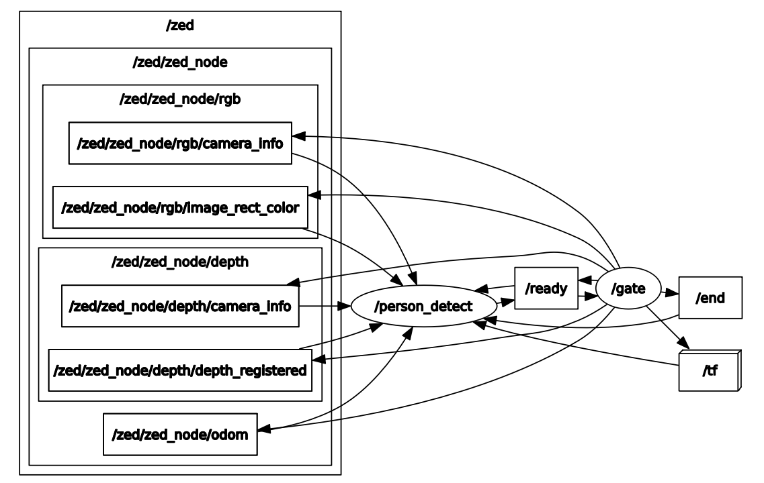

Methodology
Implementation
Joshua Eckels
|
Accessibility Constraint Mapping for On-Road, Off-Road, Indoor Autonomous Transit and Delivery
August 8, 2019

Slide 5
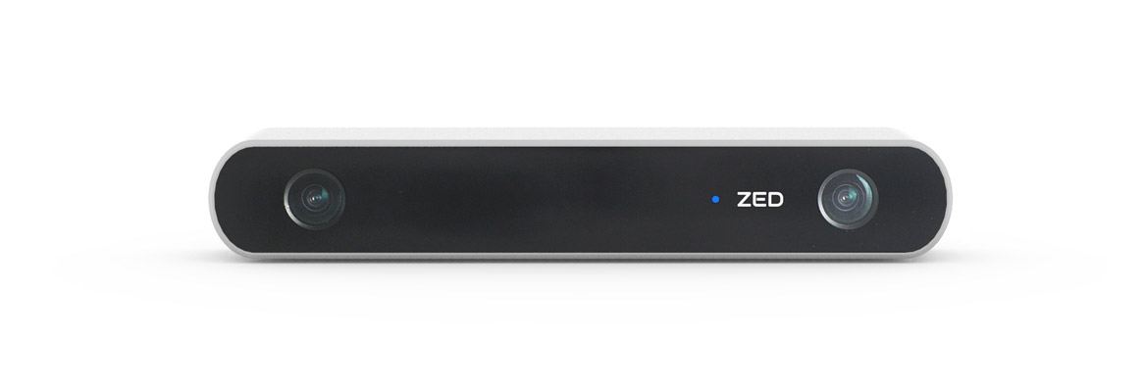
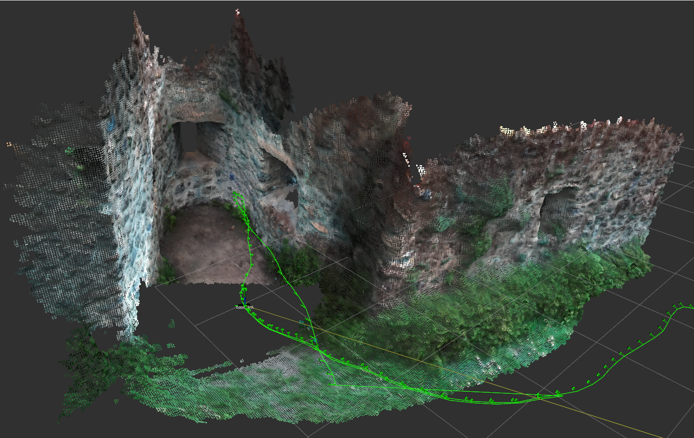
Results
ZED mapping
Real time object detection
Image localization
3D camera frame
Transform global frame
Data aggregation
Data export
Joshua Eckels
|
Accessibility Constraint Mapping for On-Road, Off-Road, Indoor Autonomous Transit and Delivery
August 8, 2019

Slide 6
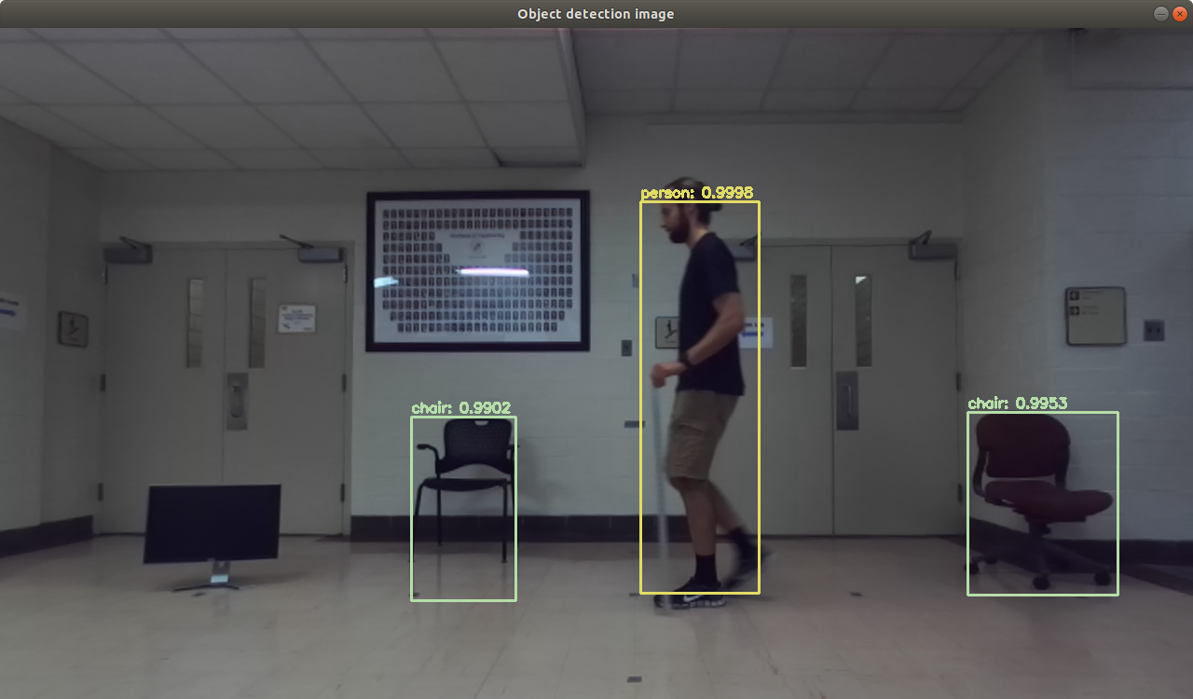
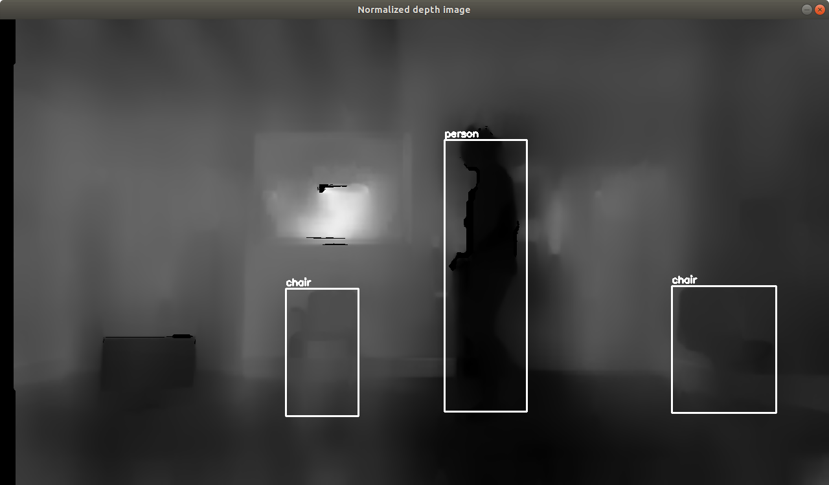
Results
ZED mapping
Real time object detection
Image localization
3D camera frame
Transform global frame
Data aggregation
Data export
Joshua Eckels
|
Accessibility Constraint Mapping for On-Road, Off-Road, Indoor Autonomous Transit and Delivery
August 8, 2019

Slide 7
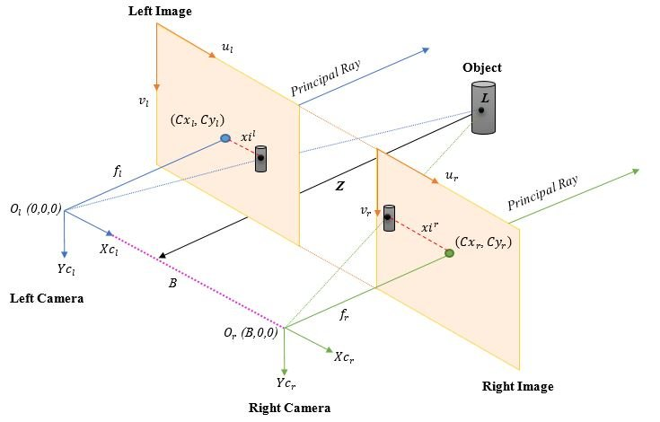
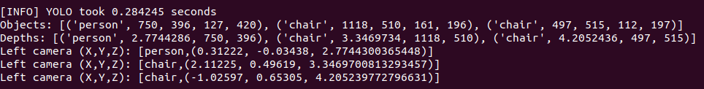
Results
ZED mapping
Real time object detection
Image localization
3D camera frame
Transform global frame
Data aggregation
Data export
Joshua Eckels
|
Accessibility Constraint Mapping for On-Road, Off-Road, Indoor Autonomous Transit and Delivery
August 8, 2019

Slide 8
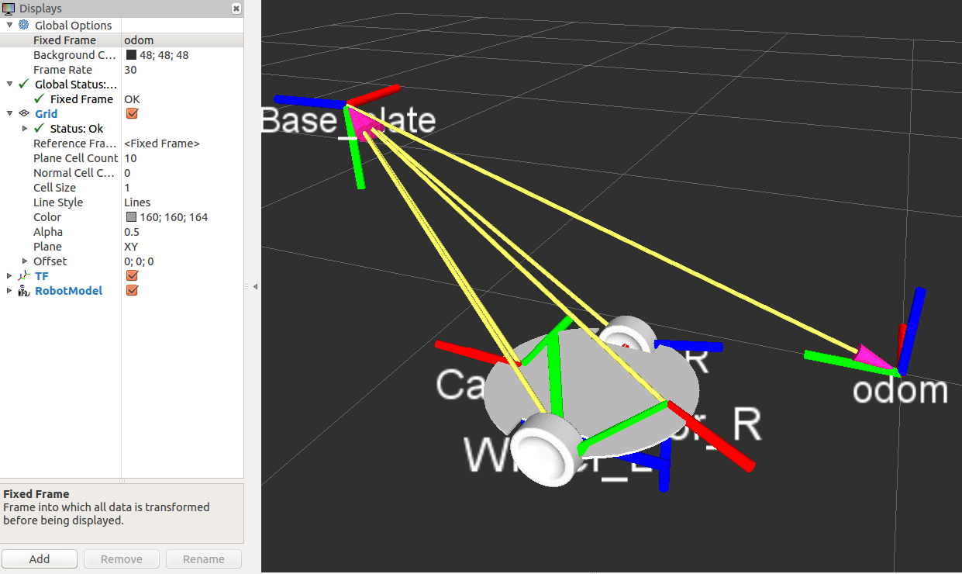
Results
ZED mapping
Real time object detection
Image localization
3D camera frame
Transform global frame
Data aggregation
Data export
Joshua Eckels
|
Accessibility Constraint Mapping for On-Road, Off-Road, Indoor Autonomous Transit and Delivery
August 8, 2019

Slide 9
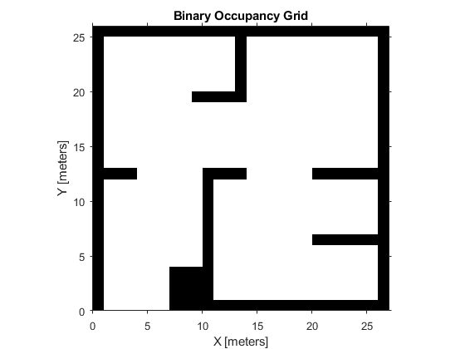
Results
ZED mapping
Real time object detection
Image localization
3D camera frame
Transform global frame
Data aggregation
Data export
Joshua Eckels
|
Accessibility Constraint Mapping for On-Road, Off-Road, Indoor Autonomous Transit and Delivery
August 8, 2019

Slide 10
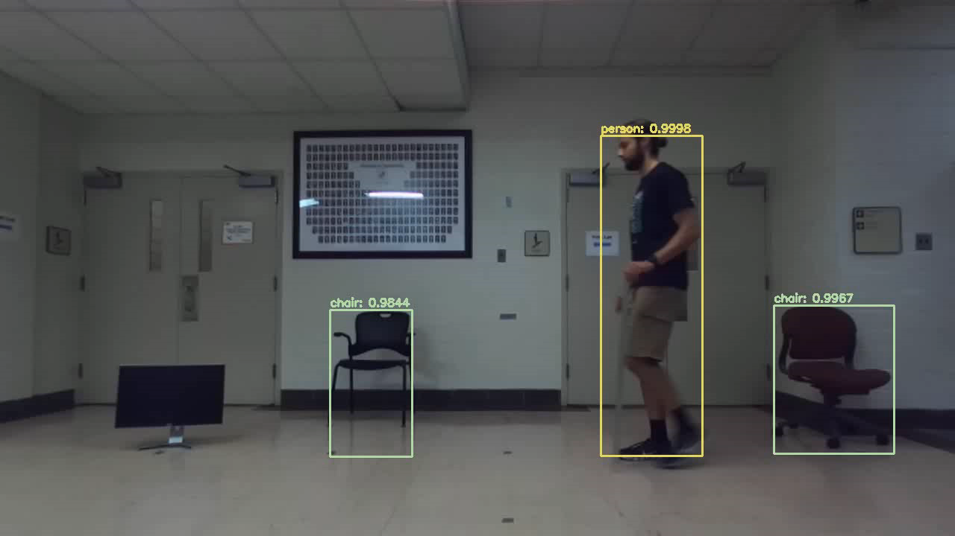
Discussion
Learned?
Software installation
Poor documentation
Timing
Transforms
Python 2 and 3
Rabbits, Whales, and
Wheels
Joshua Eckels
|
Accessibility Constraint Mapping for On-Road, Off-Road, Indoor Autonomous Transit and Delivery
August 8, 2019

Slide 11
Conclusion
Future Work
Training neural networks – doors, stairs, handicapped buttons, terrain
Integration with existing SLAM software
Multi-session global mapping
Non-visual recognizers
Front-end
Joshua Eckels
|
Accessibility Constraint Mapping for On-Road, Off-Road, Indoor Autonomous Transit and Delivery
August 8, 2019

Slide 12
References
https://ieeexplore.ieee.org/abstract/document/6629610
https://www.pyimagesearch.com/2018/11/12/yolo-object-detection-with-opencv/
https://www.researchgate.net/figure/a-Depth-data-estimation-b-Left-image-and-depth-map-relation_fig3_325854193
https://support.stereolabs.com/hc/en-us/articles/360007497173-What-is-the-calibration-file-
http://nicolas.burrus.name/index.php/Research/KinectCalibration
http://pointclouds.org/documentation/tutorials
https://medium.com/@beta_b0t/how-to-setup-ros-with-python-3-44a69ca36674
https://docs.opencv.org/3.0-beta/doc/py_tutorials/py_tutorials.html
https://www.arunponnusamy.com/yolo-object-detection-opencv-python.html
https://elcharolin.wordpress.com/2017/09/06/transforming-a-depth-map-into-a-3d-point-cloud/
https://catkin-tools.readthedocs.io/en/latest/
Joshua Eckels
|
Accessibility Constraint Mapping for On-Road, Off-Road, Indoor Autonomous Transit and Delivery
August 8, 2019

Slide 13
Acknowledgements
This research was funded in part through a grant from the U.S. National Science Foundation (EEC-award 1560107). The opinions expressed in this paper are those of the authors and not necessarily those of the U.S. National Science Foundation.
Project work alongside graduate mentor Hani Awni and researcher Enea Dushaj.
Project hosted by Virginia Tech and Technische Universität Darmstadt.
Joshua Eckels
|
Accessibility Constraint Mapping for On-Road, Off-Road, Indoor Autonomous Transit and Delivery
August 8, 2019

Slide 14
Questions?
Joshua Eckels
|
Accessibility Constraint Mapping for On-Road, Off-Road, Indoor Autonomous Transit and Delivery
August 8, 2019

